Slide 1
Connecticut: Drugs, Death, and the Data
David Hinton, Allison Gallant, Shivani Sampathkumar

Slide 2
Dream Team
David “The Code Wizard” Hinton: chief coder and project mastermind
Allison Gallant: background information, research, pharma intel, David’s support system
Shivani Sampathkumar: results analysis, pharma intel, David’s supporter part 2

Slide 3
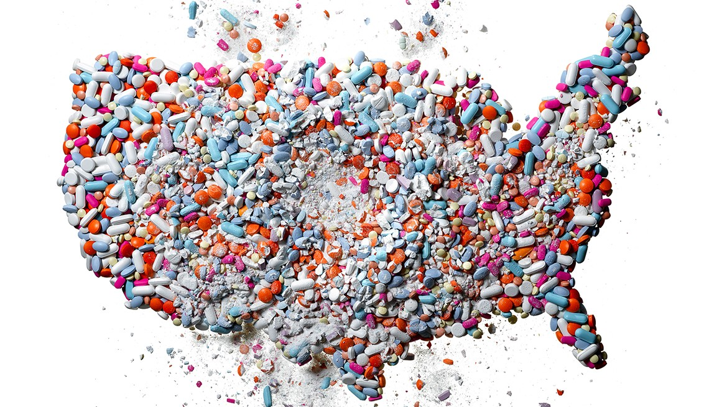
An Opioid Crisis: How did we get here?
1914: Harrison Narcotics Act
1980’s: “Addiction Rare in Patients Treated with Narcotics”
1998: FDA approves first drug containing Fentanyl for prescription use
2007: Purdue Pharma is sued by state governments for misleading advertising of OxyContin
2010’s: FDA approves abuse-deterrent OxyContin formulation
2016: CDC guidelines for prescribing opioids for chronic pain management
2017: President’s Commission on Combating Drug Addiction and the Opioid Crisis
Notes:
Harrison Narcotics Act - required practicing doctors to write prescriptions for narcotics, required drug distributors and manufacturers to register with the Treasury Department and pay taxes for their products
“Addiction Rare in Patients Treated with Narcotics” - New England Journal of Medicine publishes one paragraph summary of database that reported a low percentage of opioid users develop an addiction. This was misleading because the study only examined hospitalized patients who were closely monitored by staff during their treatment
Actiq - approved for chronic pain management in cancer patients
Purdue Pharma - advertised OxyContin as a non-addictive alternative to other medical opioids without disclosing any of the risks, plead guilty and paid almost 635 million in fines, a few months later the company paid another 24 million in compensation for damages caused by the widespread OxyContin abuse in Appalachia
“Abuse-deterrent” - drugs could not be crushed making snorting and injection impossible
CDC guidelines - encouraged prescription of OTC painkillers including acetaminophen and ibuprofen
Opioid Crisis - Trump declares the crisis a national public health emergency

Slide 4
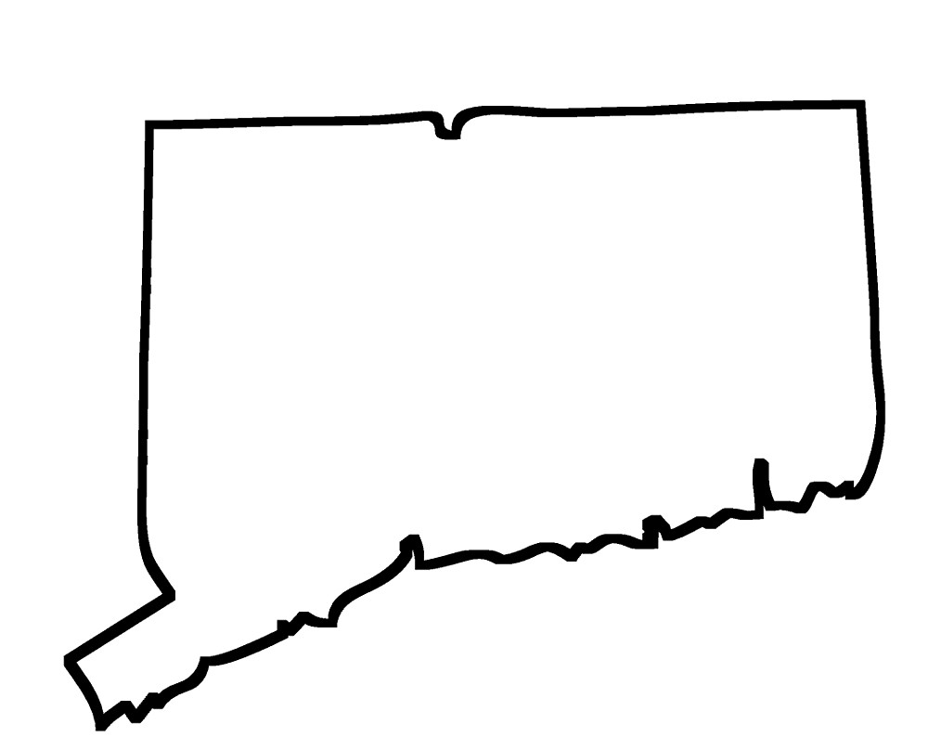
Our Research
Connecticut counties 2012-2016
Opioid overdose deaths
Admittance to opioid treatment facilities
Access to government housing assistance
Specific drug found in system at time of death
How have accidental drug-related death rates changed in Connecticut counties between 2012 and 2016 compared to the number of opioid-related treatment admissions, government housing assistance, and what specific drug was found in the system at the time of death?

Slide 5

Motivation
What can influence the number of drug-related deaths in a population?
Policies
Government programs and assistance
As future healthcare professionals....
The role of the pharmaceutical industry
The responsibility of pharmacists

Slide 6
Data Description
The Primary dataset
Office of the Chief Medical Examiner - accidental drug related deaths, which includes toxicity reports, death certificate, as well as a scene investigation.
Supporting datasets
Department of Mental Health and Addiction Services - opioid related treatment admissions, which includes Town level data on depicting the number of entries, and individuals served per year in treatment programs.
Department of Housing - affordable housing, which includes counts of assisted housing units or housing receiving financial assistance under any governmental program.

Slide 7
Methods
The group of interest in this study are those factors resulting in an opioid-related death.
Linear - Regression:
Coefficient: Total Assisted Units (0.9355) and Admissions (0.7938).
Intercept: 0.004821
Total Assisted Units vs Fentanyl Deaths
R-squared: 64%
Total Admissions vs Fentanyl Deaths
R-squared: 52%
Clustering:
K-means: 3
X: Total Assisted Units and Admissions to Treatment
y: Fentanyl related deaths
Notes:
What do you try to accomplish? What method (data mining techniques) did you adopt? What are the strengths of your method? Describe the systematic approach how you achieve your specific goal, and justify your method with supporting argument through evaluation.
independent = Total Assisted Units & Admissions
Predicted = Fentanly Related Death

Slide 8
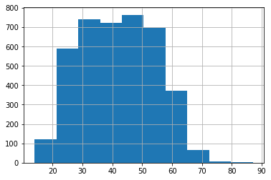
Results: Population Age
Age versus Overdose Deaths
Number of Deaths
Age
Notes:
MAKE THIS A HISTOGRAM
Average age:
Figure 1. Age versus Overdose Deaths: This graph shows that deaths due to overdose are concentrated in the 30-55 age group and slightly less in 20-30 or 60-70 age groups

Slide 9
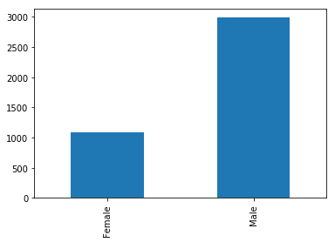
Results: Population Sex
Number of Deaths versus Sex
Number of Deaths
Sex
Notes:
Ratio of females to males:
Figure 2. Number of Overdose Deaths versus Sex: This bar graph shows that deaths from opioid overdose were almost three times as likely in males than in females.

Slide 10
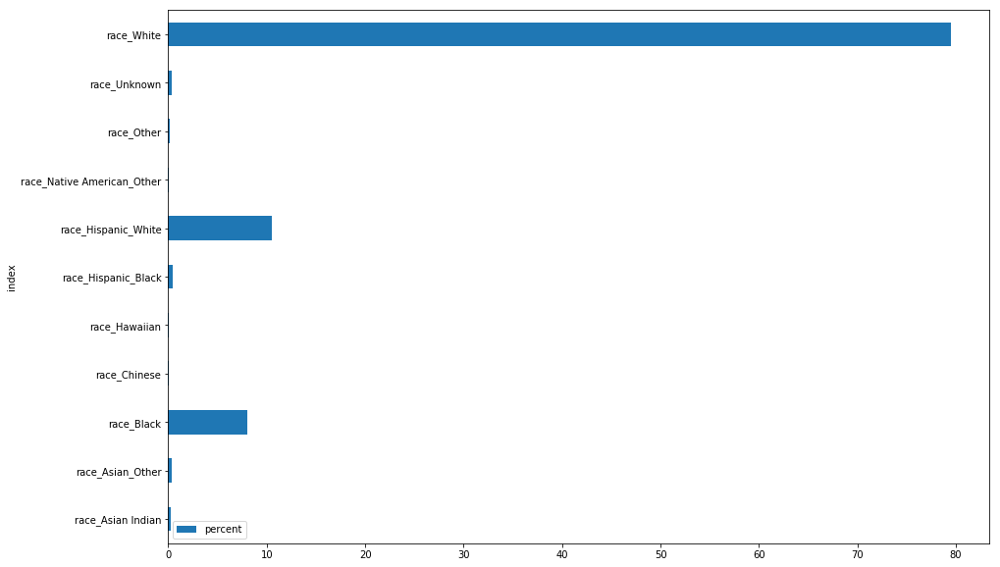
Results: Population Race
Notes:
Percentages:
Figure 3. Population Race versus Overdose Deaths: From this chart we can tell...

Slide 11
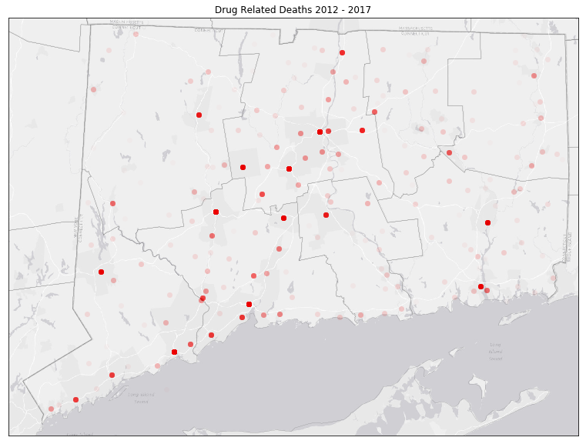
Results: Location
Notes:
Map of counties for each year compiled into a gif.
Figure 4. Location by County of Overdose Deaths: Shows the areas that opioid overdoses were primarily in central connecticut. This shows that the location of opioid overdoses may not be sporadic. Instead, there a specific area in which opioid overdoses are common

Slide 12
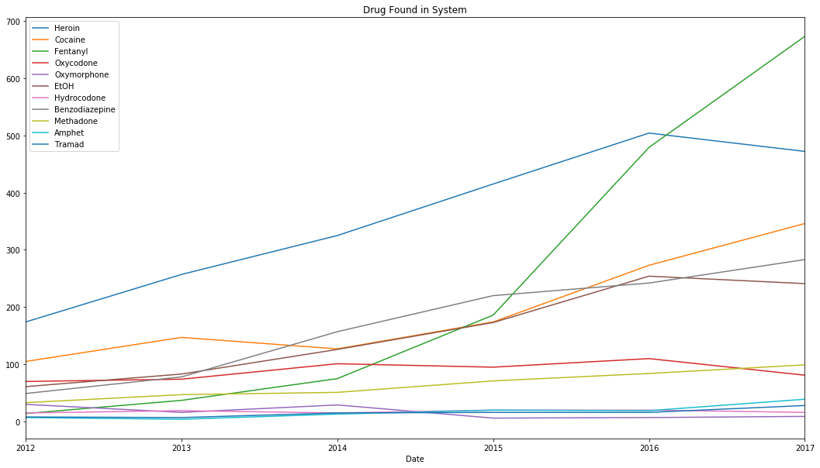
Results: Drug Used
Notes:
Figure 7. Drug Found in System Between 2012-2017: This chart shows….
Blue - heroin
Green - fentanyl
Grey - benzodiazepine
Orange - cocaine
Red - oxycodone

Slide 13
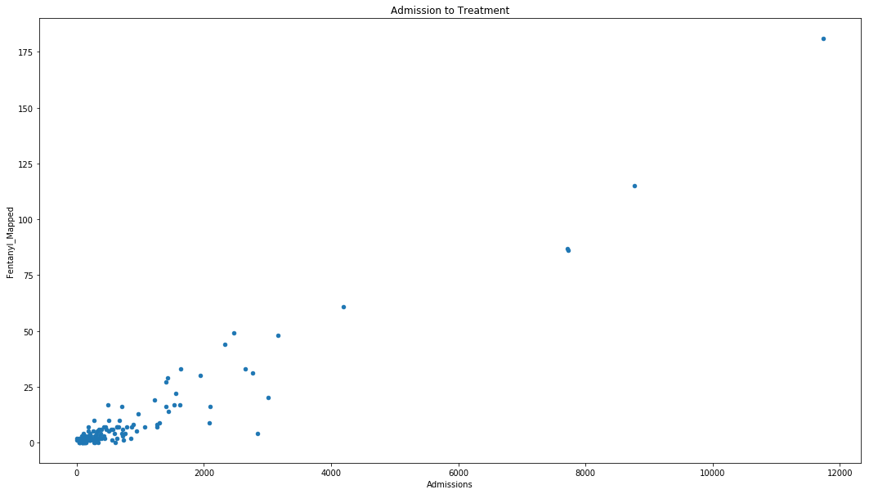
Results: Access to Treatment
Notes:
Comparison of deaths and treatment admissions
Figure 5. Access to Treatment versus Fentanyl Overdose Deaths per County: This chart reveals that….
Admissions on x axis

Slide 14
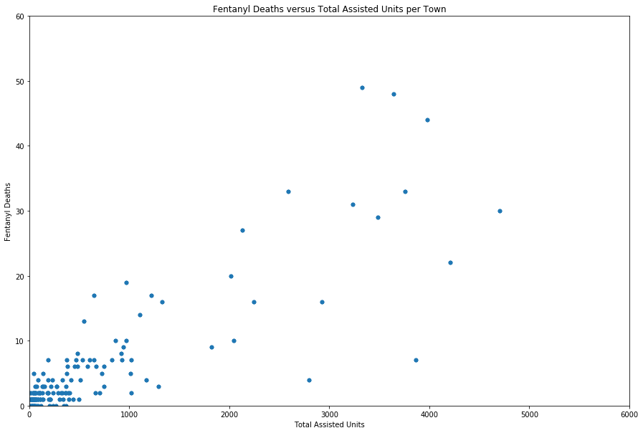
Results: Government Assistance versus Fentanyl Deaths
Notes:
Government housing assistance often received by low-income families, senior citizens, and the disabled.
Figure 6. Government Assistance versus Fentanyl Overdose Deaths per County: The relationship between fentanyl deaths and the number of assisted units in each county is...

Slide 15
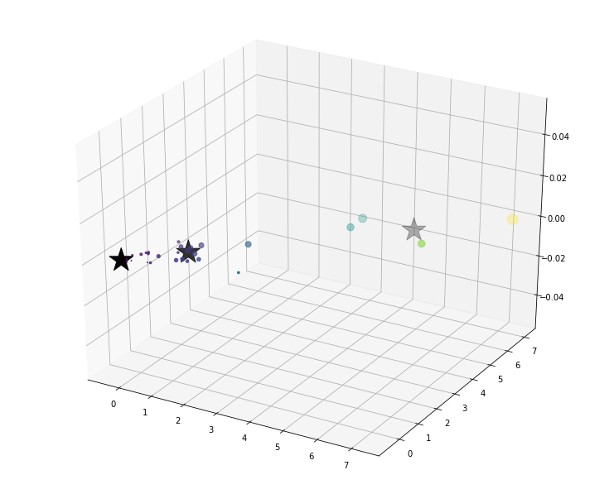
Our Model
1
0
Fentanyl Deaths
(normalized)
2
Admissions
Housing Assistance
Notes:
ax.scatter(X['Total Assisted Units'], X['Admissions'], c=X['Total Assisted Units']*10,s=y['Fentanyl_Mapped']*20)
ax.scatter(C[:, 0], C[:, 1], marker='*', c='#050505', s=900)
Cluster 1 =
Cluster 2 =
Cluster 3 =

Slide 16
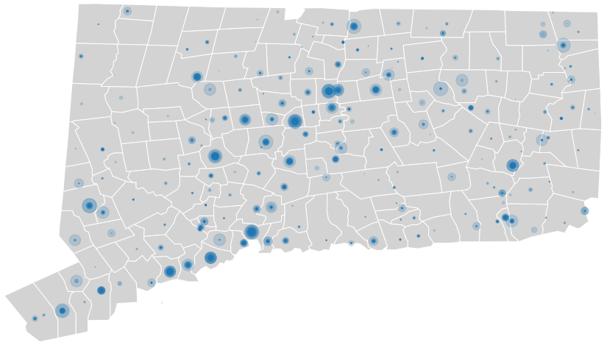
Cluster 1
Cluster 2
Cluster 0

Slide 17
Our Model
1
0
Fentanyl Deaths
(normalized)
2
Admissions
Housing Assistance
Notes:
ax.scatter(X['Total Assisted Units'], X['Admissions'], c=X['Total Assisted Units']*10,s=y['Fentanyl_Mapped']*20)
ax.scatter(C[:, 0], C[:, 1], marker='*', c='#050505', s=900)
Cluster 1 =
Cluster 2 =
Cluster 3 =

Slide 18
Limitations
Linear regression model didn’t fit multivariable data
R2 = 52%
Problems normalizing fentanyl deaths

Slide 19
Resources
HHS Office, and Public Affairs. “About the U.S. Opioid Epidemic.” HHS.gov, US Department of Health and Human Services, 6 Mar. 2018, www.hhs.gov/opioids/about-the-epidemic/.
“Opioid Overdose.” Centers for Disease Control and Prevention, Centers for Disease Control and Prevention, 23 Oct. 2017, www.cdc.gov/drugoverdose/.
Volkow, Nora, and Francis Collins. “‘All Scientific Hands on Deck’ to End the Opioid Crisis.”Advancing Addiction Science, National Institute on Drug Abuse , 31 May 2017, www.drugabuse.gov/about-nida/noras-blog/2017/05/all-scientific-hands-deck-to-end-opioid-crisis.

Slide 20
Datasets
Accidental Drug Related Deaths 2012-2017. https://catalog.data.gov/dataset/accidental-drug-related-deaths-january-2012-sept-2015.
Opioid Related Treatment Admissions by Town in Department of Mental Health and Addiction Services Programs.https://catalog.data.gov/dataset/opioid-related-treatment-admissions-by-town-in-department-of-mental-health-and-addiction-.

Slide 21

Questions!

